Slide 1
Food Management System

Slide 2
Introduction to Food Order Management Web Application

Slide 3
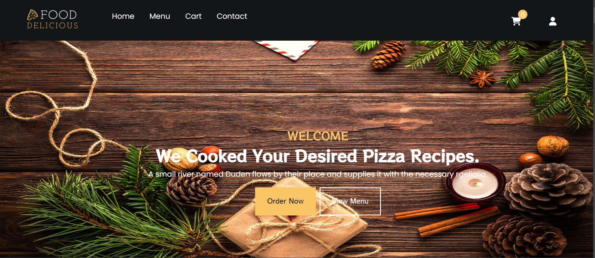
Project Definition
Definition:
A Food Management System is a web application that facilitates the management of food items, orders, and customer interactions. It enables users to browse menus, place orders, and manage their cart seamlessly through an intuitive UI

Slide 4
Objective
Objective:
"To build a user-friendly food ordering and management system that streamlines the ordering process for customers while ensuring efficient handling of orders and food items by the restaurant staff."
Key Goals:
Create a responsive and interactive platform.
Ensure seamless integration of the cart and menu system.
Provide real-time order management capabilities.

Slide 5
Project Scope
Responsive web design
Interactive food menu
User-friendly interface for food search/filter
Bill Download
Scope
Cart functionality for order management
Order submission and summary

Slide 6
Deliverables
01
03
Functional components for menu, cart, and order management
A responsive web application
02
04
Documentation on system structure and functionalities
Interactive UI with Bootstrap and React

Slide 7
Project Modules and Functionalities
Menu Module:
Order Module:
Shows a list of all available food items.
Allows users to add/remove items in the cart and place orders.
Home Module:
Navigation Module:
Display food categories and featured items.
Provides links to different sections like home, menu, and cart.
Cart Module:
Search/Filter Module:
Displays all items added to the cart with total price calculation.
Enables users to search or filter food items based on categories or keywords.

Slide 8
New Technologies Used/Learned
HTML & CSS
Define the styling and layout of web pages, making them more visually appealing, user-friendly, and accessible.
Bootstrap:
Used for responsive, mobile-first design and pre-built UI components.
React JS:
Leveraged to build dynamic, reusable components and manage application state.
React Router:
For handling navigation between different pages and views in the application.
React Hooks:
Learned and implemented hooks like useState and useEffect for state management and side-effects handling.

Slide 9
System Workflow
User Interface:
User Interface
Users interact with the UI to browse the food menu, select items, and place orders.
State Management:
React manages the state of the cart and order list.
State Management
Future Enhancements
Order Processing:
Once the order is placed, the system handles order confirmation and displays an order summary.
Future Enhancements:
Order Processing
Could include adding a backend to store and manage orders.

Slide 10
Admin Panel for Food Management System

Slide 11
01
This Admin Panel provides an overview of the food order management system's functionalities.
02
Designed to manage food items, orders, and customer interactions efficiently.
Objective

Slide 12
Technology
HTML
CSS
REACT JS
NODE JS
MONGO DB

Slide 13
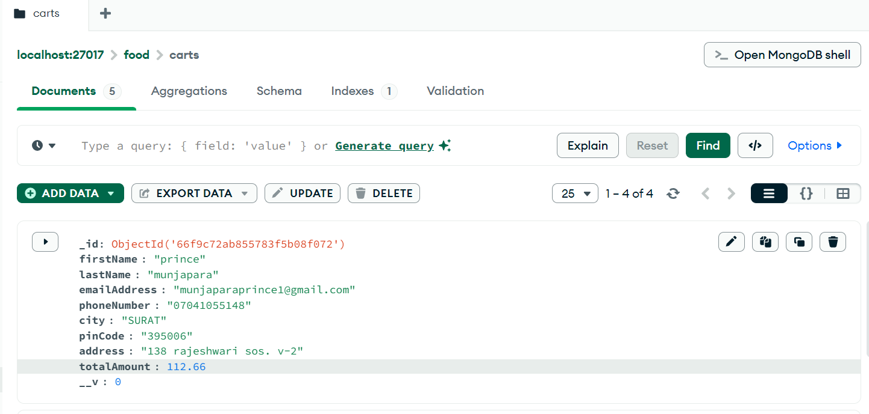
Database
Check Out Data store to Mongo DB database.

Slide 14
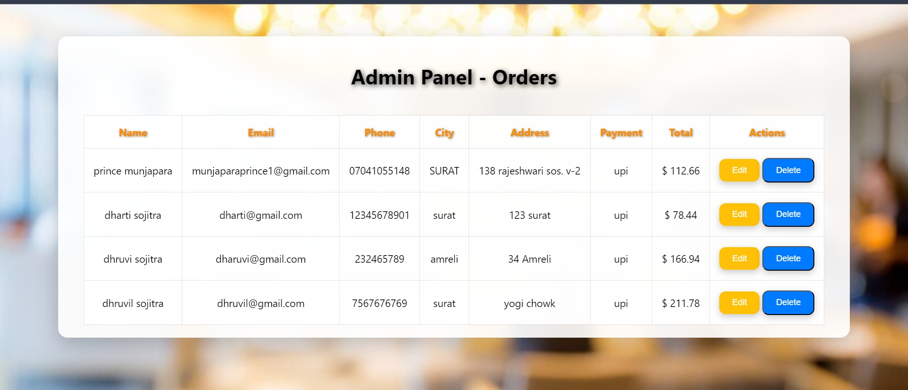
Admin Panel
All order data show in Admin panel.
Admin can update data and delete data.
Update data and delete data to direct database.

Slide 15
THANK YOU

